Slide 1
DESIGN AND ANALYSIS OF ALGORITHMS
SUBMITTED BY: MAYANK
ROLL NO.:181210029
SUBMITTED TO: DR. CHANDRESH KUMAR MAURYA

Slide 2
Elementary Graph Algorithms

Slide 3
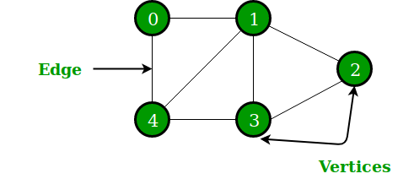
GRAPH:-
A graph G = (V, E)
where, V → set of vertices
E → set of edges

Slide 4
Graph Representation :-
Given a graph G = (V, E)
The graph may be directed or undirected
There are two common ways to represent graphs for algorithms:
Adjacency lists.
Adjacency matrix.

Slide 5
Adjacency Lists:-
Array Adj of |V| lists, one per vertex
Vertex u’s list has all vertices v such that
(u, v) ∈ E

Slide 6
ADJACENCY MATRIX :-
The adjacency-matrix representation of a graph G consists of a V×V matrix A_{ij}
such that :
A_{ij} = 1, if (i, j) ϵ E
0, otherwise

Slide 7
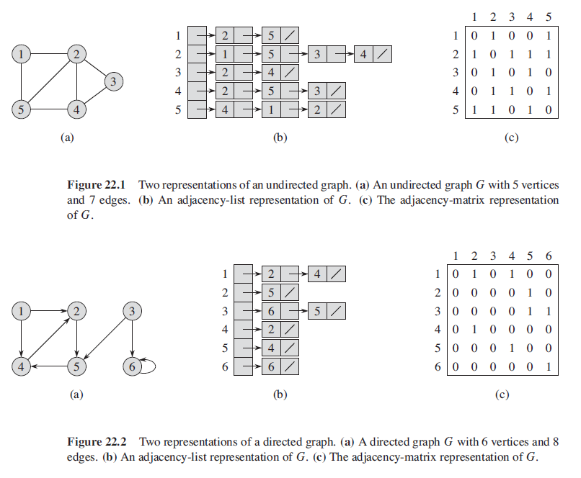
EXAMPLE:-

Slide 8
GRAPH SEARCH ALGORITHMS :-
There are two type of searching algorithms
1. breadth first search
2. depth first search

Slide 9
BREADTH FIRST SEARCH :-
Breadth-first search (BFS) is an algorithm for traversing or searching tree or graph data structures. We need to know two important terminology to understand the process of BFS traversal.
Visiting a Vertex : This mean we are currently present on that vertex in the graph or tree.
Exploration of a Vertex : This refers to visiting all the adjacent vertices of the source vertex or the visiting vertex.

Slide 10
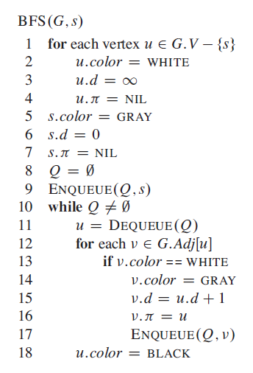
ALGORITHM :-

Slide 11
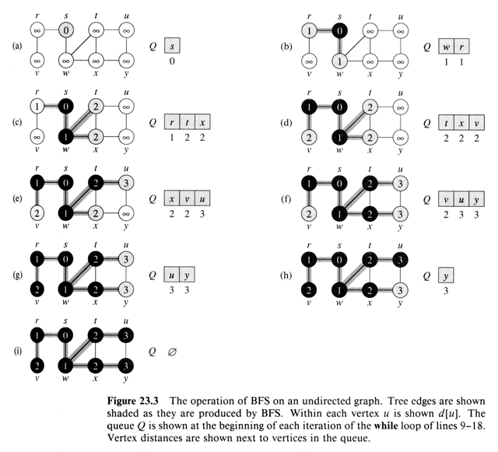
EXAMPLE :-

Slide 12
DEPTH FIRST SEARCH:-
The strategy followed by depth-first search is, as its name implies, to search deeper in the graph whenever possible.
DEPTH-FIRST SEARCH TRAVERSAL (DFS):
Depth-first search explores edges out of the most recently discovered vertex v that still has un-explored edges leaving it.
Once all of v’s edges have been explored, the search “backtracks” to explore edges leaving the vertex from which v was discovered.

Slide 13
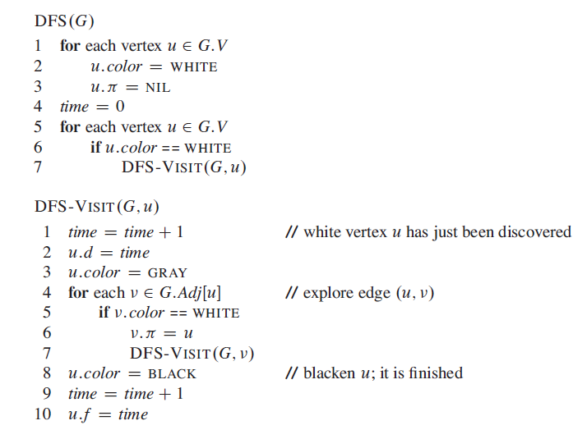
ALGORITHM :-

Slide 14
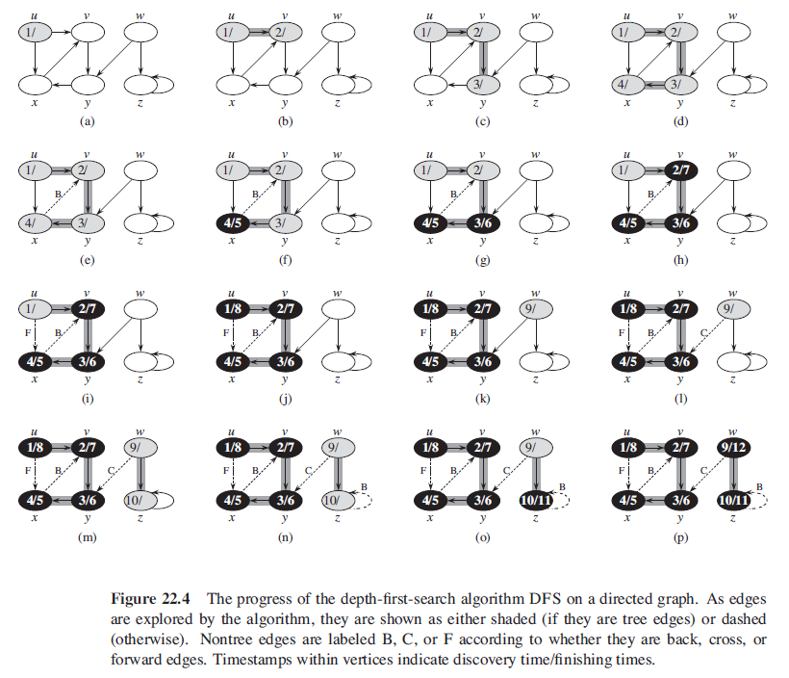
EXAMPLE :-

Slide 15
MINIMUM SPANNING TREE

Slide 16
MINIMUM SPANNING TREE:-
A minimum spanning tree (MST) or minimum weight spanning tree is a subset of the edges of a connected, edge-weighted undirected graph that connects all the vertices together, without any cycles and with the minimum possible total edge weight.

Slide 17
METHODS TO FIND MINIMUM SPANNING TREE :-
A minimum spanning tree has (V – 1) edges where V is the number of vertices in the given graph.
There are mainly two methods used to find minimum spanning out of a connected weighted graph :-
Prim’s algorithm
Kruskal’s algorithm

Slide 18
PRIM’S ALGORITHM :-
Prim’s algorithm is also a Greedy algorithm.
It starts with an empty spanning tree. The idea is to maintain two sets of vertices.
The first set contains the vertices already included in the MST, the other set contains the vertices not yet included.
At every step, it considers all the edges that connect the two sets, and picks the minimum weight edge from these edges.
After picking the edge, it moves the other endpoint of the edge to the set containing MST.

Slide 19
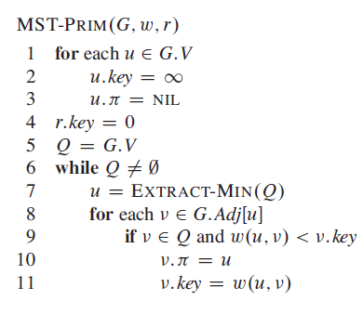
ALGORITHM :-

Slide 20
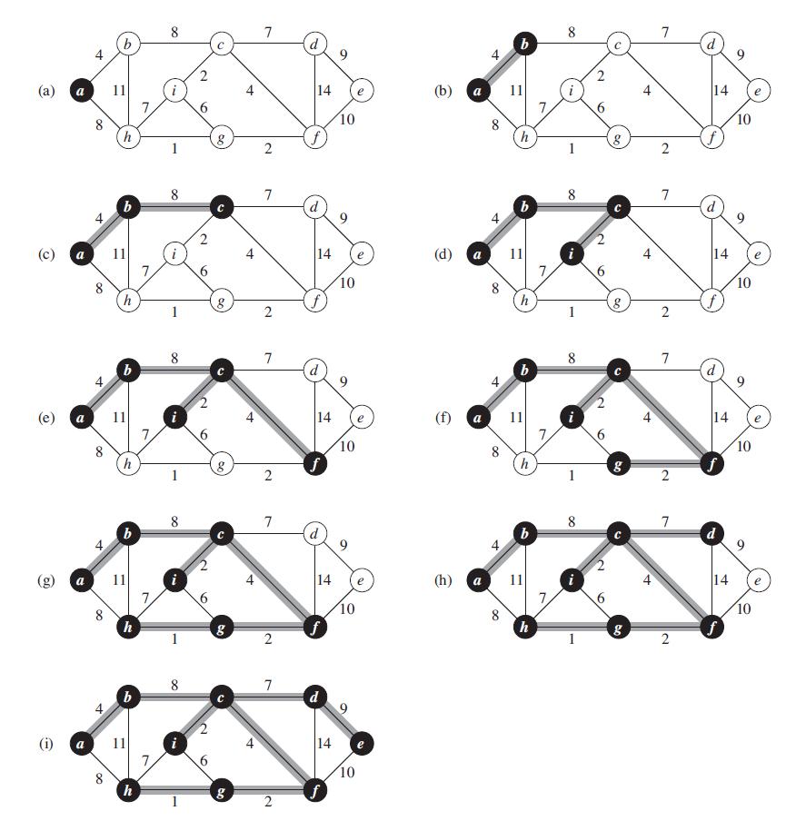
EXAMPLE :-

Slide 21
KRUSKAL’S ALGORITHM :-
Kruskal's algorithm is a minimum-spanning-tree algorithm which finds an edge of the least possible weight that connects any two trees in the forest. It is a greedy algorithm in graph theory as it finds a minimum spanning tree for a connected weighted graph adding increasing cost arcs at each step.
Below are the steps for finding MST using Kruskal’s algorithm :
Sort all the edges in non-decreasing order of their weight.
Pick the smallest edge. Check if it forms a cycle with the spanning tree formed so far. If cycle is not formed, include this edge. Else, discard it.
Repeat step#2 until there are (V-1) edges in the spanning tree.

Slide 22
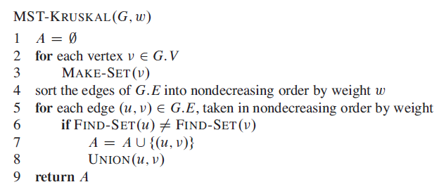
ALGORITHM :-

Slide 23
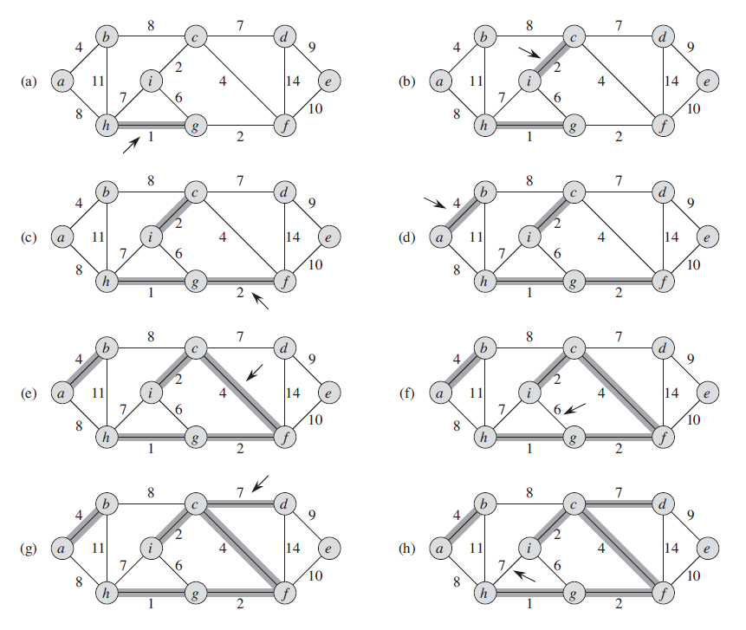
EXAMPLE :-

Slide 24
Single-source shortest path

Slide 25
Single-source shortest path
The single-source shortest path problem, in which we have to find shortest paths from a source vertex v to all other vertices in the graph.
The single-destination shortest path problem, in which we have to find shortest paths from all vertices in the directed graph to a single destination vertex v.

Slide 26
SINGLE SOURCE SHORTEST PATH-DIJKSTRA’S ALGORITHM
We generate a SPT (shortest path tree) with given source as root.
We maintain two sets, one set contains vertices included in shortest path tree, other set includes vertices not yet included in shortest path tree.
At every step of the algorithm, we find a vertex which is in the other set (set of not yet included) and has a minimum distance from the source.

Slide 27
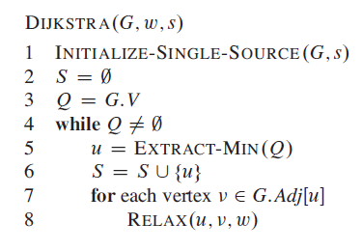
ALGORITHM :-

Slide 28
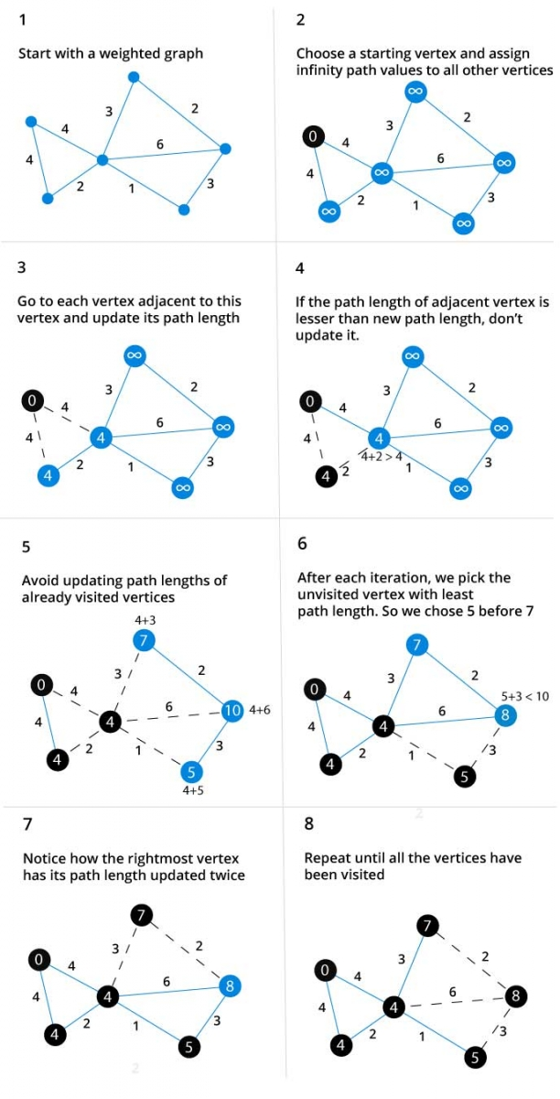
EXAMPLE :-

Slide 29
SINGLE SOURCE SHORTEST PATH-BELLMAN FORD ALGORITHM
Dijkstra doesn’t work for Graphs with negative weight edges.
Bellman-Ford works for such graphs. Bellman-Ford is also simpler than Dijkstra and suites well for distributed systems.
But time complexity of Bellman-Ford is O(VE), which is more than Dijkstra.
Negative weight edges might seem useless at first
but they can explain a lot of phenomena like : -
Cash flow
Heat released
Heat absorbed

Slide 30
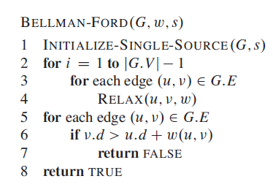
ALGORITHM :-

Slide 31
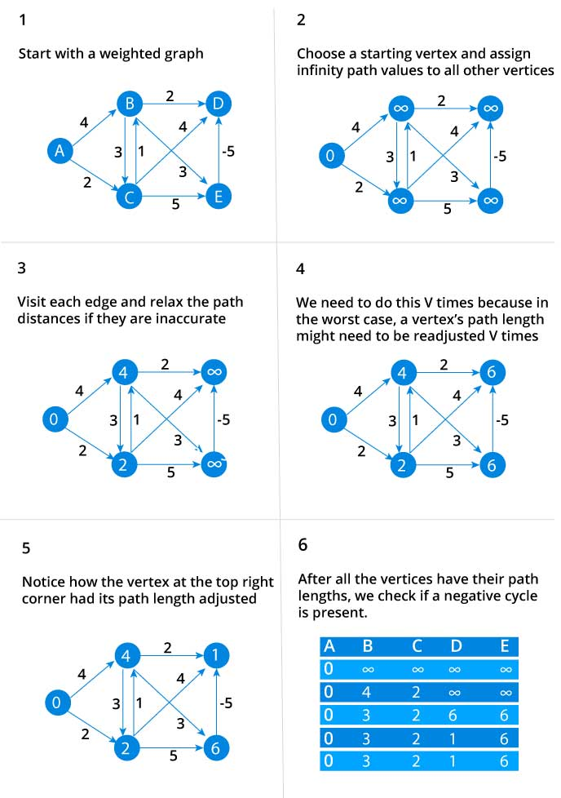
EXAMPLE :-

Slide 32
ALL PAIR SHORTEST PATH

Slide 33
ALL PAIR SHORTEST PATH(FLOYD-WARSHALL’S ALGORITHM): WORKING
In all pair shortest path, when a weighted graph is represented by its weight matrix W then objective is to find the distance between every pair of nodes.
We will apply dynamic programming to solve the all pairs shortest path.
In all pair shortest path algorithm, we first decomposed the given problem into sub problems.
In this principle of optimally is used for solving the problem.
It means any sub path of shortest path is a shortest path between the end nodes.

Slide 34
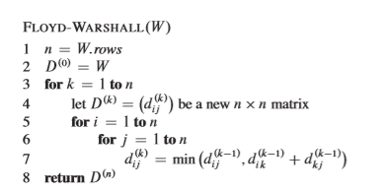
ALGORITHM :-

Slide 35
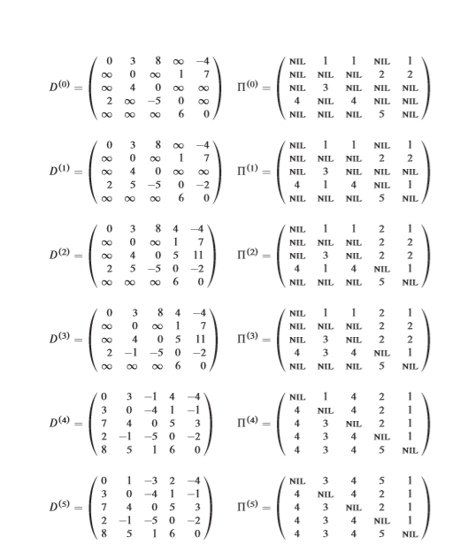
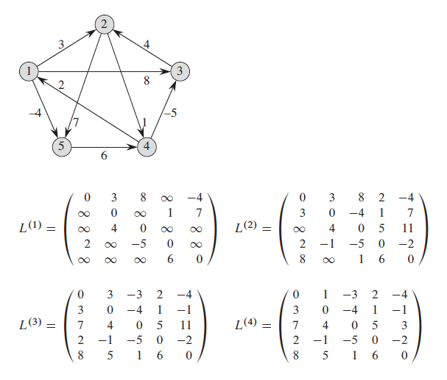
EXAMPLE :-

Slide 36
THANK YOU

